Slide 1
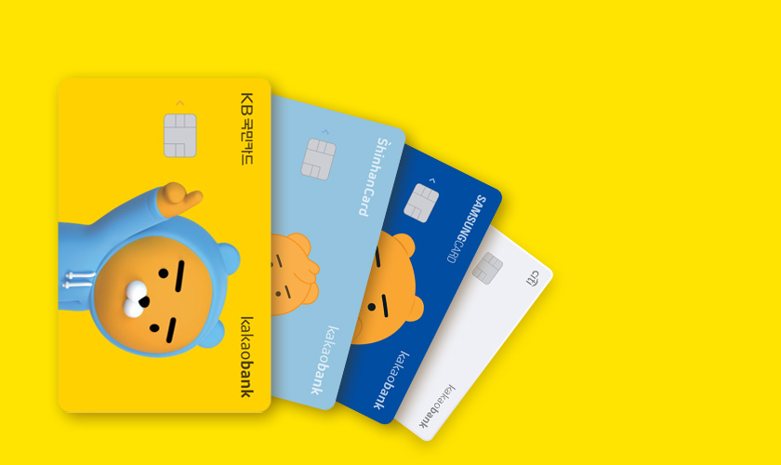
Which card should we recommend to Which customer?
Customer classification model for marketing at credit card company
Se Bi Yang from AI Bootcamp 13th

Slide 2
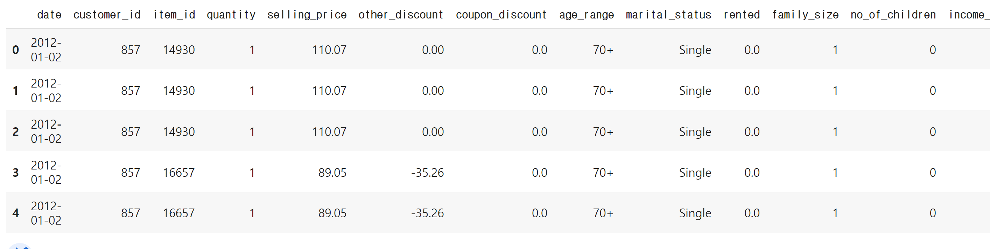
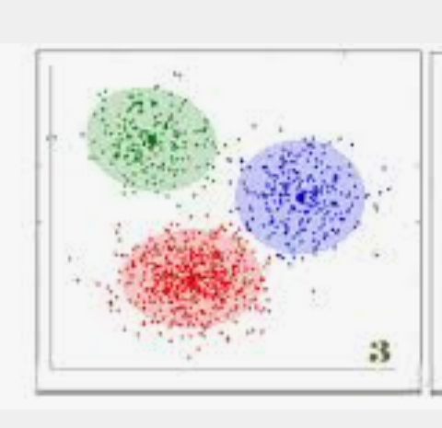

1. Flow of the project
10
Market Share
40
Market Share
50
Market Share
%
%
%
Set Hypothesis
EDA
Search credit card data and decide which to use for machine learning
Clustering
K-means clustering
Divide credit card customer data into 5 different types using cluster
Classification
Multi Output Classifier
Set 5 different types of customer as target data and make multioutput classification model

Slide 3
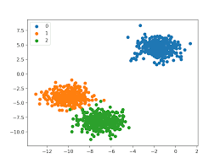

2. Set Hypothesis & EDA
X
Hypothesis1.
Customer card usage would take shape of Cluster
-How many clusters would there be?
-What properties do the clusters have?
-How could we use the clusters for card marketing?
Hypothesis2.
Customers would be classified as cluster
-Classification model would help marketing for upcoming customers at the company
-It could work as recommendation algorithm
100
100

Slide 4
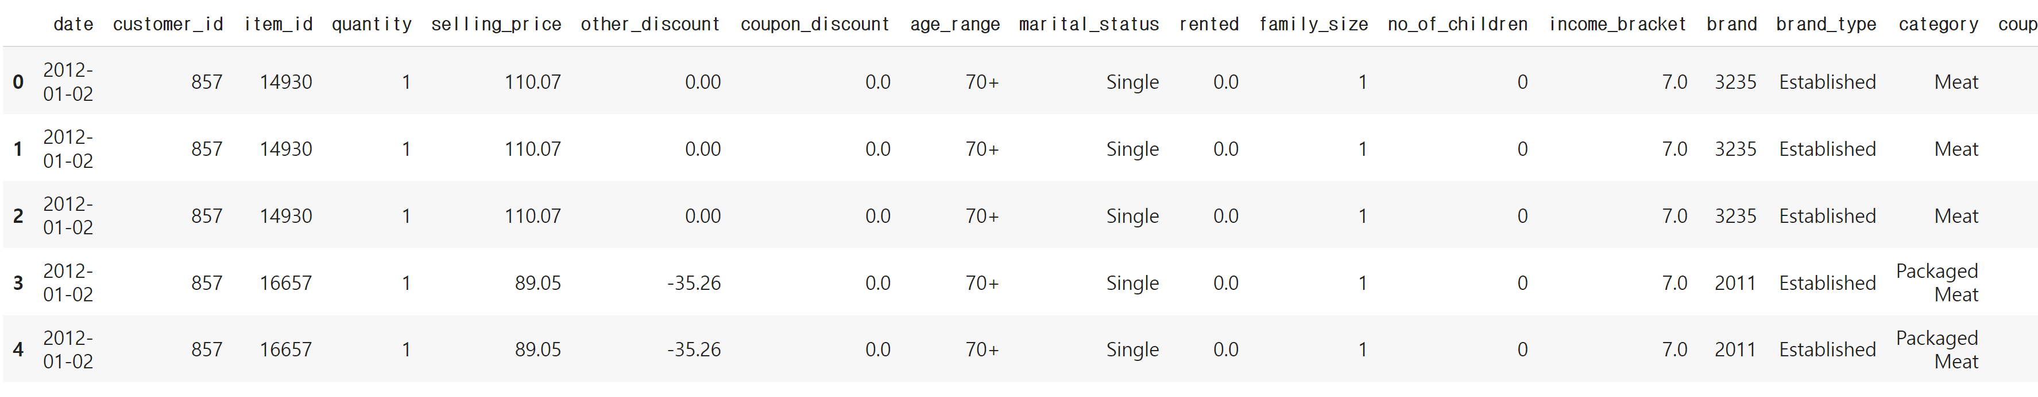
2. Set Hypothesis & EDA
고
X
This is the preprocessed dataset. It usually contains data related with customer purchase and personal information
With this data, we will first start making clustering model using k-means clustering

Slide 5
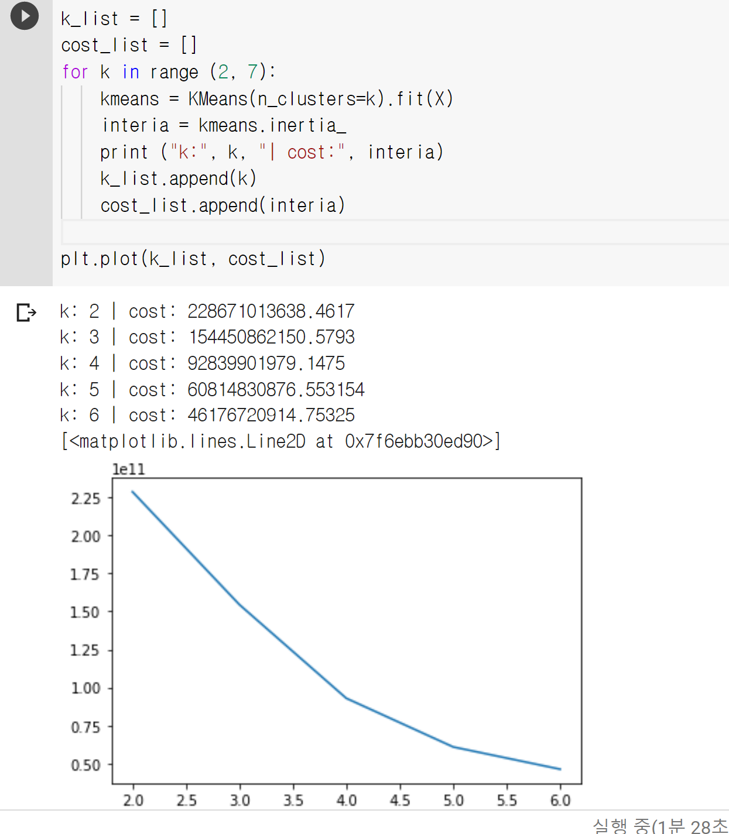
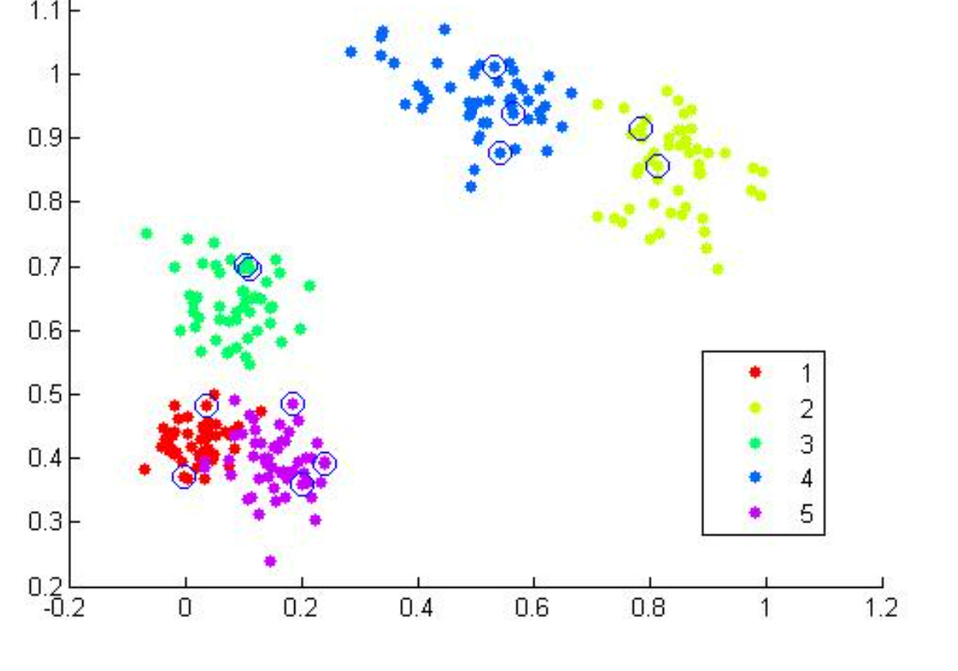
3. Clustering (k-means clustering)
ㅇ
X
K-means clustering
K-means clustering refers to the method that aims to partition the observations into k clusters using centriod
Inerita
Inerita refers to the evaluation index of k-means clustering, which shows how much the datasets are strongly partitioned together
This is an image just for the understanding
make 5 other clusters which is recommended by k-means clustering

Slide 6
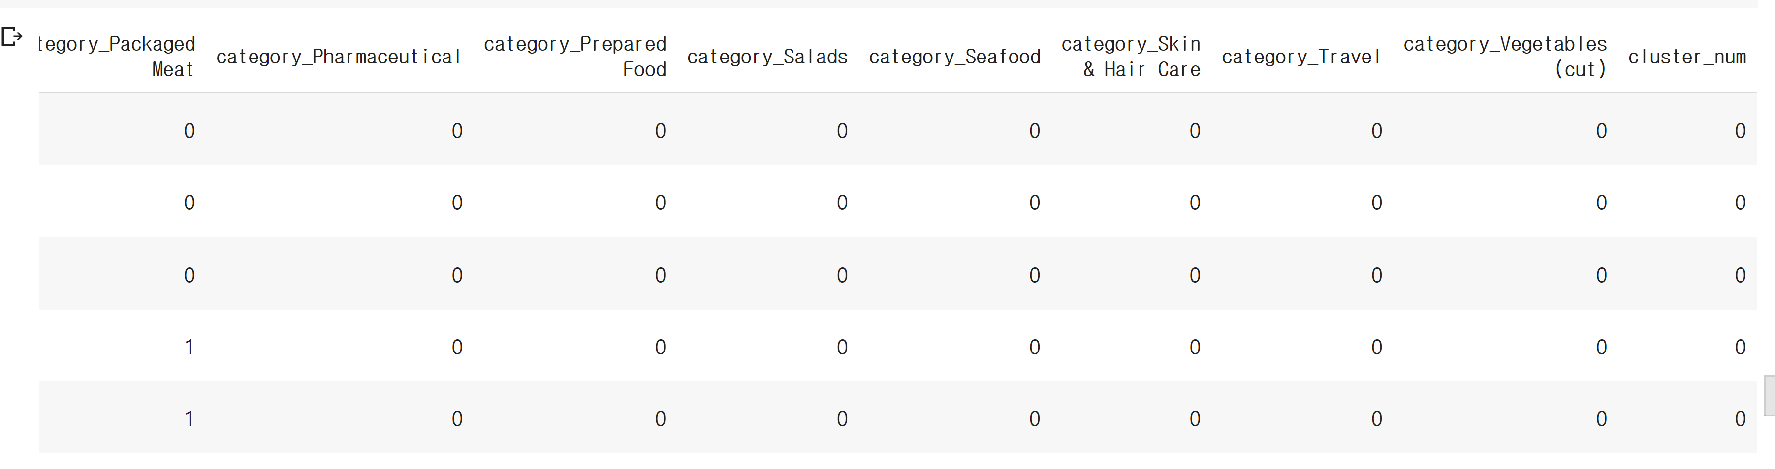
3. Clustering (k-means clustering)
X
Added new column: cluster prediction
Values
Cluster_num above shows which cluster it belongs to
The value consists of 0-4 , 5 clusters in total

Slide 7
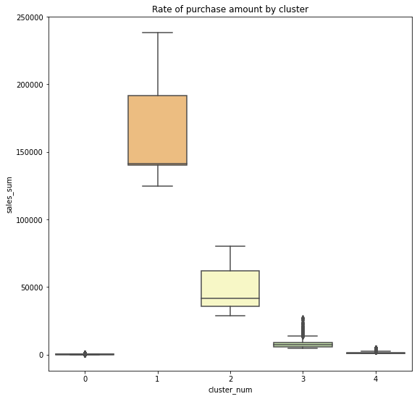
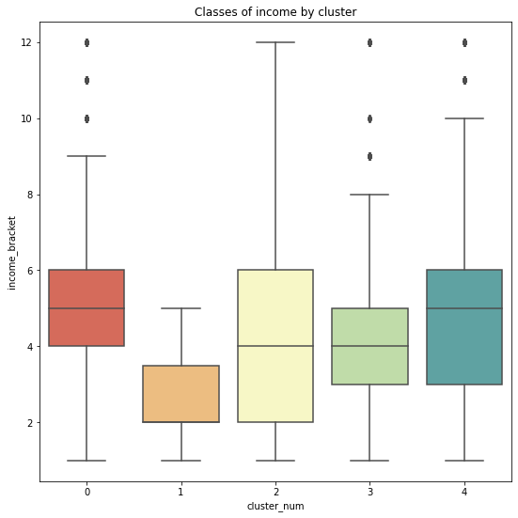
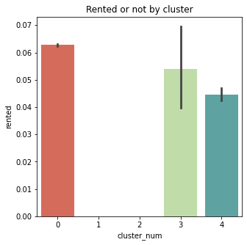
3. Clustering (k-means clustering)
ㅇ
X
EDA progression for classified groups, attributes of 5 clusters are analyzed based on attributes
Purchase amount
Classes of income
Rented or Property owned

Slide 8
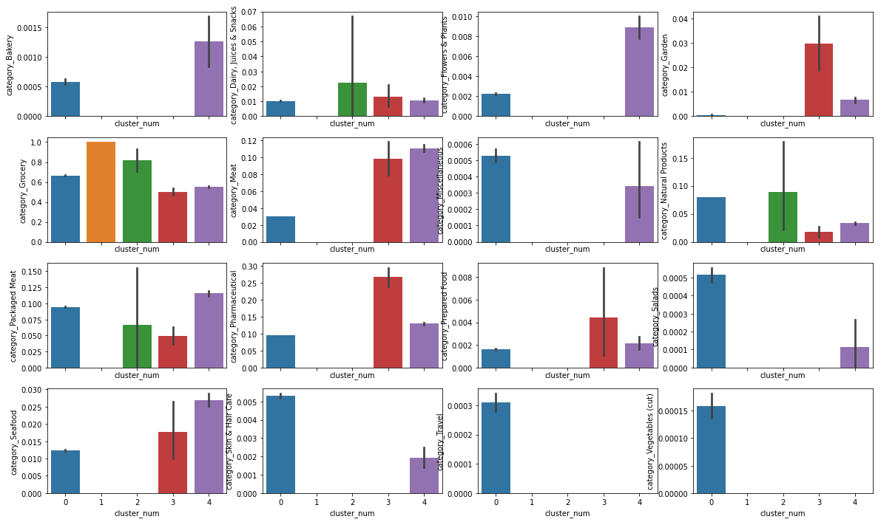
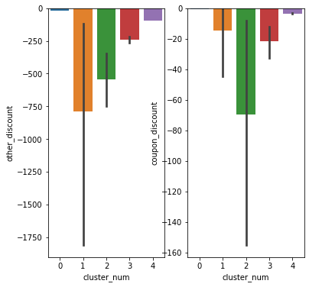
3. Clustering (k-means clustering)
ㅇ
X
Preferred purchase items amount of discount by means

Slide 9
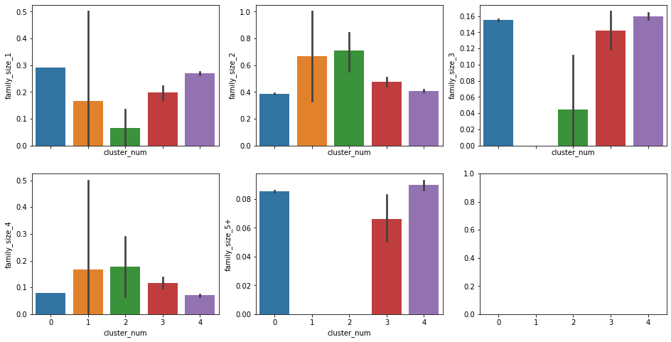
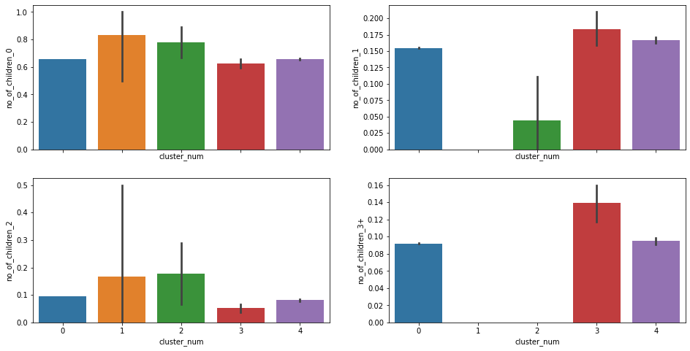
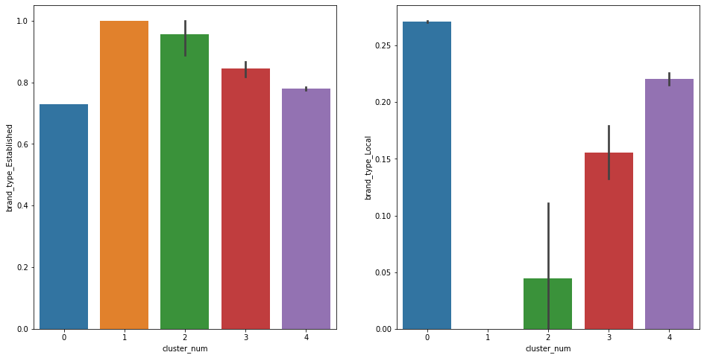
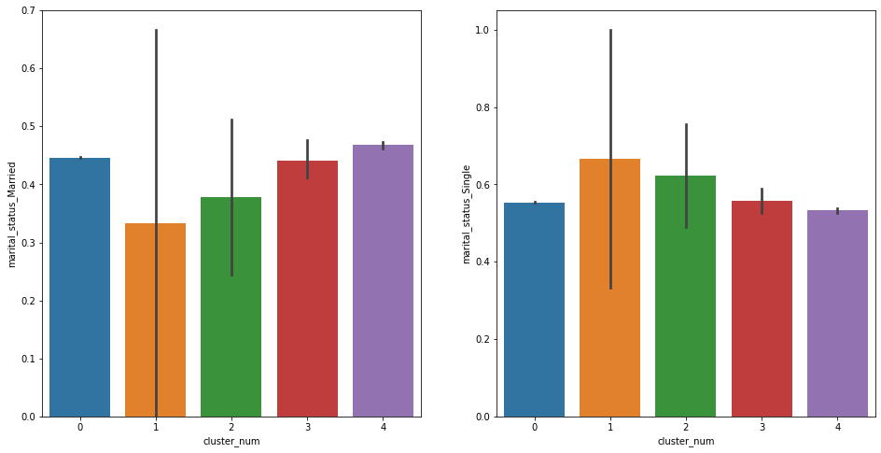
3. Clustering (k-means clustering)
ㅇ
X
Number of family members, Number of children, Preferred brand, Marital status

Slide 10



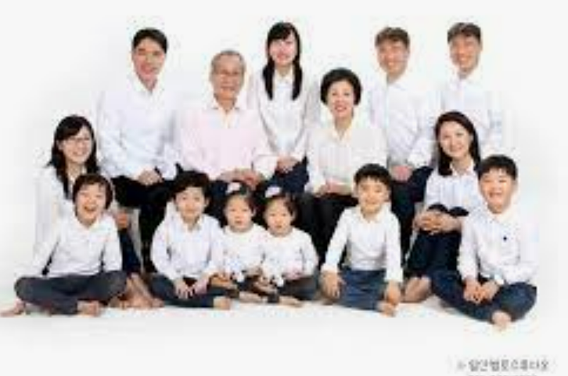
3. Clustering (k-means clustering)
**estimated as
single Youths**
**estimated as married couples**
**considered as
outliers**
**estimated as big family members**
**estimated as elderlies**
CLUSTER 1
Middle class & low purchase power
Over 70s
Large family, preferred local products
Purchased items related with travel, healthcare, salads, vegetables
CLUSTER 2
1. Lowest imcome & strongest purchase power
2. 30s-50s
3. Single, no children, small family size
4. Preferred Franchised Groceries
CLUSTER 3
Middle class & low purchase power
2. usually distributed among 20s & 30s
3. Married, Three family members, with single child
4. Purchased Meat, Seafood, Natural Products, Dairy products
CLUSTER 4
Categories varied across all attributes characterize X
CLUSTER 5
Middle class & low purchase power
2. Various age range
3. Married, large family, many kids
4. No brand preferences, purchased a lot of items

Slide 11
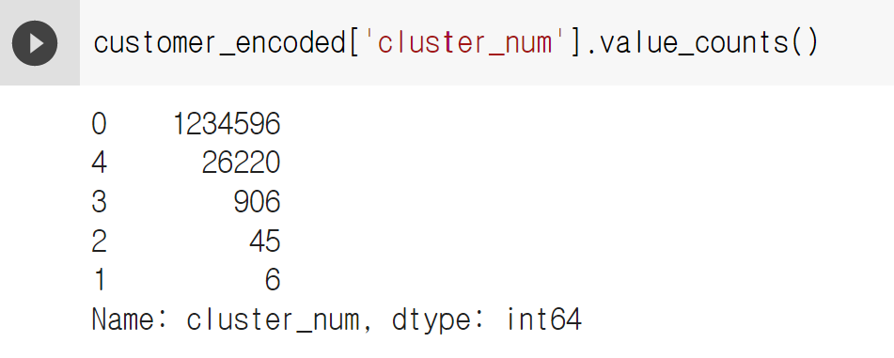
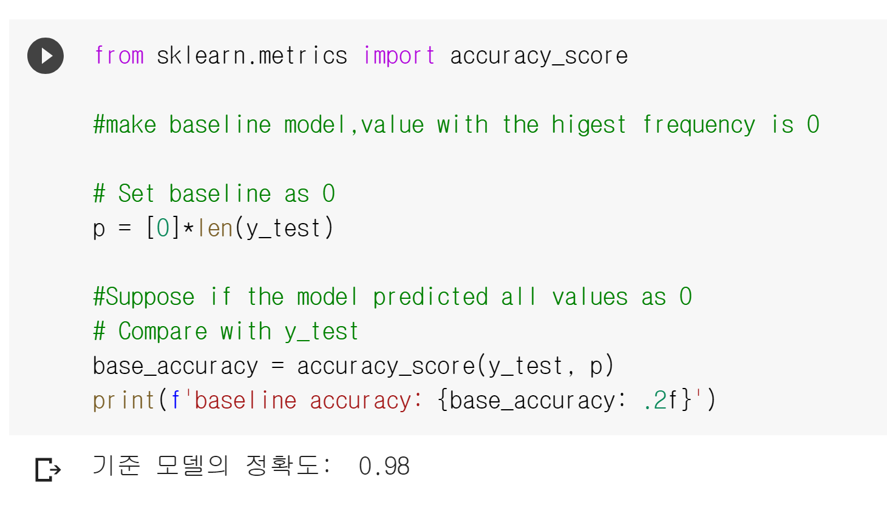
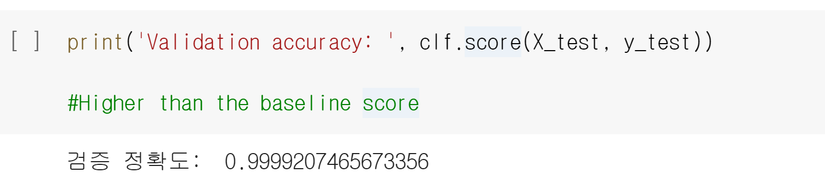
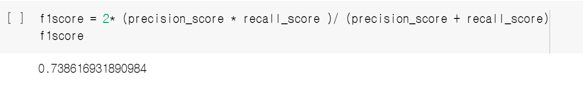
4. Classification (Multi Output Classifier)
X
#Unbalanced class model , #Multi classification model
Multi Output Classifier, Random Forest Classifier, Randomized CV
validation accuracy
baseline accuracy

Slide 12
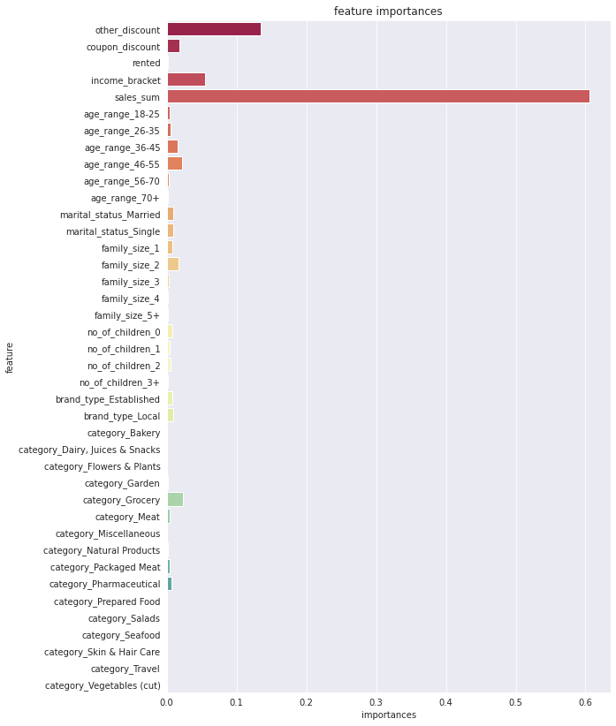
4. Classification (Multi Output Classifier)
X
Feature importances explains about model operation
-The higher, the stronger it effects on model
- “Economic indicators" such as purchase amount, discount amount, and income played the most important role

Slide 13
Validate Hypothesis
Hypothesis1.
Purchase of customer would shape as clusters
Hypothesis2.
New customers would be classified as cluster
Both True
The card company could use this model as a stepping stone for card recommendation algorithms to market faster and more accurately when attracting new customers In particular, it can target groups with high purchasing potential, such as those with high income but weak purchasing power

Slide 14
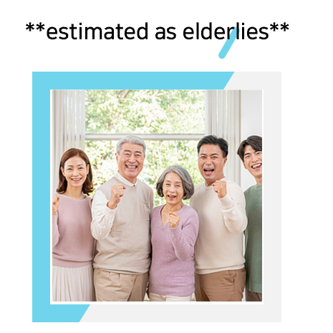
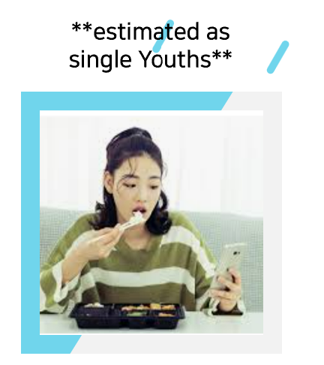
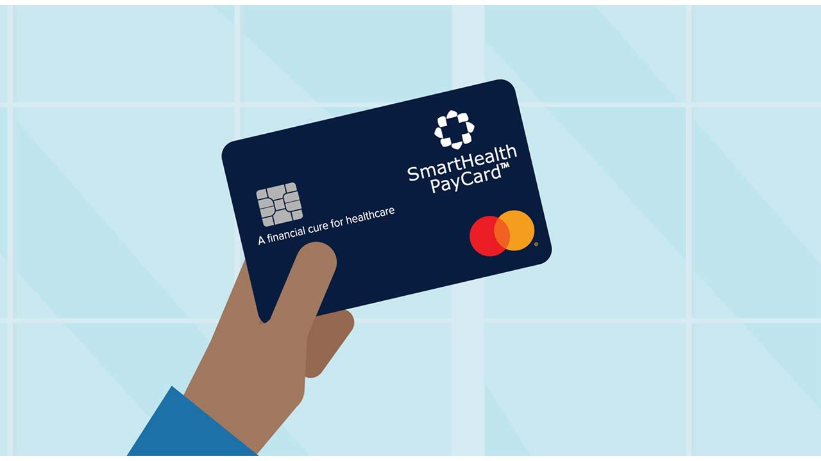
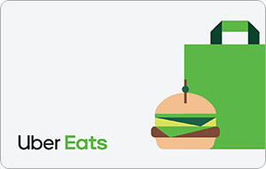
Marketing Examples
-Healthcare credit card
-Promote travel packs every month
-Helper service subscription
-Uber eats credit card
-communities subscription

Slide 15
Thanks for Listening
Consumer classification for the establishment of marketing strategies by consumer of credit card companies
AIB13th Se Bi Yang

